Slide 1
CUSTOMER RELATIONSHIP MANAGEMENT
CONCEPTS AND TECHNOLOGIES
Chapter 12
Managing investor and employee relationships

Slide 2
Owner/investor relationships are important
Owners and investors are significant stakeholders in businesses.
They are an important source of capital that allows businesses to be established, operate and grow, and in return they expect the value of that capital to grow.
They want shareholder value to be created.
Shareholder value can only be created if the business makes a return on investment that is greater than the weighted average cost of the capital invested in the business (WACC).

Slide 3
Linking CRM and shareholder value
The value of a business is the present day value of all margins that will be earned from sales to customers in the future.
This emphasises the important CRM goal of maximising customer life-time value (LTV).
The value of a business is equal to the LTV generated by its customers.

Slide 4
CRM competences that influence shareholder value 1
Target market selection.
  Target markets vary in their attractiveness. Where demand is falling or static, or there is intense competition, margins come under pressure with negative consequences for shareholder value. Shareholders prefer markets that show signs of both margin and growth.
Customer acquisition.
  Effective and efficient customer acquisition reduces the costs of acquisition but grows the numbers of new customers acquired.
Customer retention. Focussed and effective customer retention means that strategically-significant customers are retained, as is their life-time value.
Customer development. Effective cross-selling and up-selling grows share-of-wallet and the value of retained customers.
Value proposition development. A key component of strategic CRM is the development of value propositions that customers prefer over competitors, and want to buy.
Technology implementation. CRM systems enable companies to manage the customer life-cycle more effectively and efficiently. Sales force automation ensures that opportunities are identified, tracked and moved to closure. Marketing automation ensures that campaigns and events are more effective. Service automation ensures that customers’ service requirements are satisfied cost-effectively.
Database management. Customer-related data is an important intangible asset that can be exploited to grow customer value and therefore shareholder value. CRM applications need appropriately high quality data to be effective.
Network management. Successful companies are excellent at identifying and building relationships with partners who can help create and deliver customer value.

Slide 5
CRM competences that influence shareholder value 2
Customer retention.
  Focussed and effective customer retention means that strategically-significant customers are retained, as is their life-time value.
Customer development.
  Effective cross-selling and up-selling grows share-of-wallet and the value of retained customers.
Value proposition development.
  A key component of strategic CRM is the development of value propositions that customers prefer over competitors, and want to buy.

Slide 6
CRM competences that influence shareholder value 3
Technology implementation.
  CRM systems enable companies to manage the customer life-cycle more effectively and efficiently. Sales force automation ensures that opportunities are identified, tracked and moved to closure. Marketing automation ensures that campaigns and events are more effective. Service automation ensures that customers’ service requirements are satisfied cost-effectively.

Slide 7
CRM competences that influence shareholder value 4
Database management.
  Customer-related data is an important intangible asset that can be exploited to grow customer value and therefore shareholder value. CRM applications need appropriately high quality data to be effective.
Network management.
  Successful companies are excellent at identifying and building relationships with partners who can help create and deliver customer value.

Slide 8
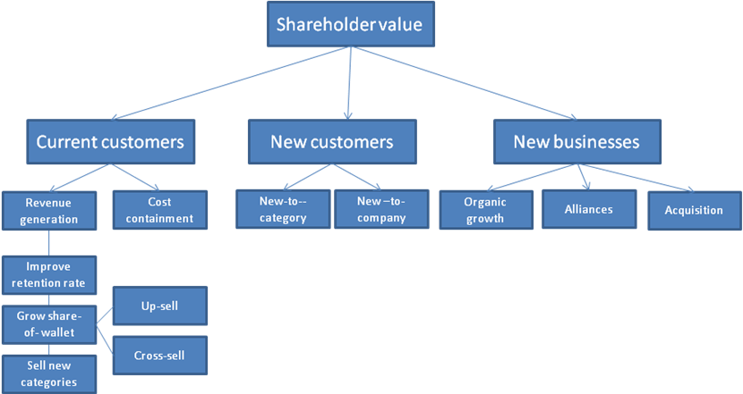
Shareholder value through CRM

Slide 9
ROI from different types of CRM
A strategic CRM implementation that involves major changes in corporate culture and restructuring of the business around customer groups, and might take 3 to 5 years to make a return
An operational CRM project such as sales force automation might yield a return within 12 to 24 months.
An analytical CRM implementation can show results almost immediately as long as the right sort of customer-related data is available to be able to run campaigns.
A collaborative CRM project might take 2 or more years to reap benefits.

Slide 10
Analytical CRM at Business Direct
Number of catalogues mailed
Mailing cost
New customers obtained 2003
Conversion rate new customers
Initial sales per new customer
Total new initial sales revenues
Acquisition cost per customer
Average customer sales 2003-2006
2 year gross margin (40%)
2003 customers still active in 2006
CRM
1000
£3,000
65
6.5%
£180
£11,700
£46.15
£7,500
£3,000
80%
Traditional
5000
£15,000
45
0.09%
£120
£5,400
£333.33
£2,200
£880
35%

Slide 11
4 strategies for developing a stable investor base
educate current investors
shift the investor mix to institutions that avoid investment churn
attract the right kind of core owner
operate as a privately owned company.

Slide 12
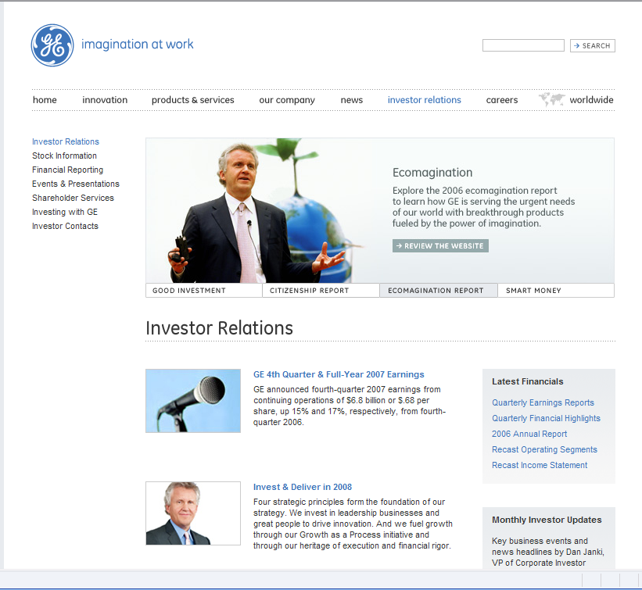
Investor relations portal

Slide 13
Whay people are important to CRM success
People design and implement the CRM strategy
People use CRM software run to help them run campaigns and events, and to sell to and service customers.
Basic human skills such as showing empathy and responding are vital to delivering excellent experience in interaction with customers.

Slide 14
Internal marketing definition
Internal marketing is a planned effort to overcome organizational resistance to change and to align, motivate and integrate employees towards the effective implementation of corporate and functional strategies

Slide 15
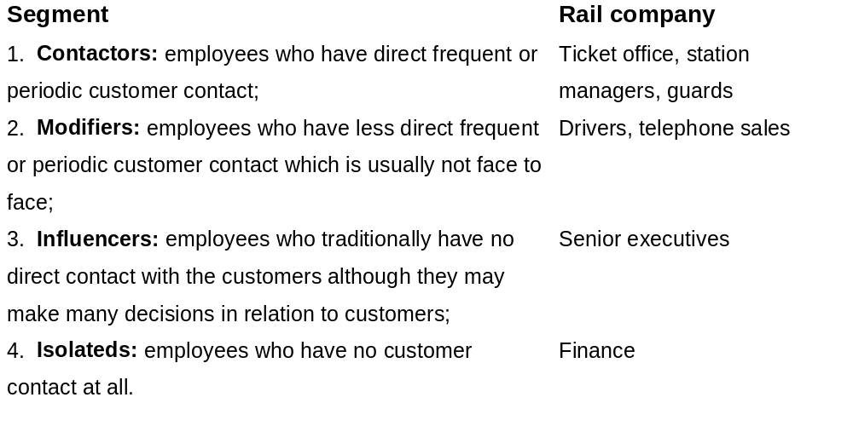
Segmenting the internal market by level of customer contact

Slide 16
Using the 7P’s as the internal marketing mix 1
Product
  Employees ‘buy’ the CRM strategies they must implement, changed work processes or other related initiatives of senior management
Price
  Psychological cost of adopting new work practices
Promotion (internal communications)
  Face-to-face briefings, corporate newspapers, employee portals, corporate videos, trail runs (c.f. sampling), incentive plans, corporate TV network (eg FedEx), road-shows, conferences

Slide 17
Using the 7P’s as the internal marketing mix 2
Place
  On-site/off-site meetings, virtual locations
Physical evidence
  Memos, briefing notes, training manuals, job descriptions
Process
  Training, coaching, direction, negotiation
Participants
  Colleagues, team-members, supervisors, CEO, trainers, consultants

Slide 18
Empowerment
Empowerment ranges from total authority to do what it takes to satisfy and retain a customer to bounded empowerment where the employee has a more limited discretion to act.
The boundaries may be financial (e.g. no more than $200 per customer) or product related (e.g. domestic appliances but not financial services).

Slide 19
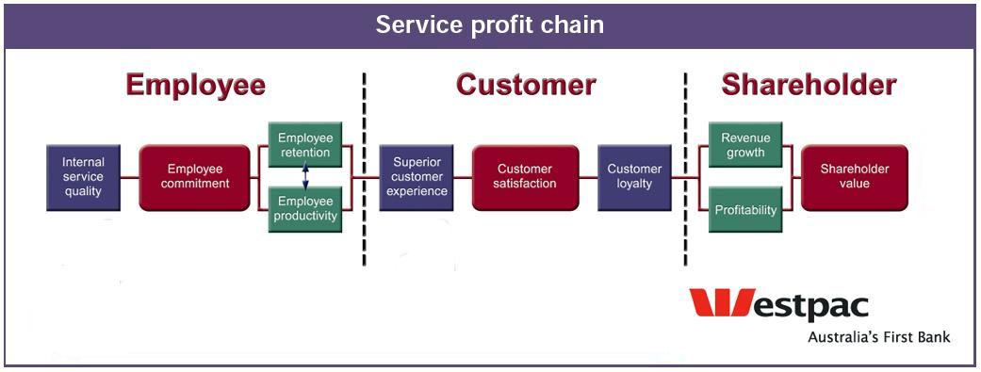
The service-profit chain at Westpac

Slide 20
Employee Relationship Management (ERM)
Employee relationship management (ERM) provides applications, content, and services that enhance the value of the employee to the organization and directly affect the activities by which employees create value for the customer. Companies today are realizing that, just as they need a single, comprehensive view of their customers—such as that provided by customer relationship management (CRM) solutions—they would also benefit from having a single view of their employees and from providing that view to the employees themselves

Slide 21
The employee portal
Employee portals are one-stop shops that provide access to all the role-relevant resources employees need to do their jobs effectively and efficiently, whether they are managers or reports.
As with many commercial websites, portals often allow employees to customize their own home-page so that role-relevant information is readily accessible.

